Slide 1
Mitosis and Stem Cells
Year 11 Human Biology
ATAR
PowerPoint #15

Slide 2
SCSA Syllabus Reference
mitosis forms part of the cell cycle producing new cells with the same genetic content
the sequence of DNA replication, chromosome duplication and chromosome separation are important processes in the production of identical daughter cells by mitosis for growth, repair and replacement of tissues within the body
stem cells have the ability to divide by mitosis and differentiate into many different tissues, depending on the level of cell potency

Slide 3
Lesson Intention
To explore the process of mitosis and its purpose for cells
To explore stem cells and the process of differentiation

Slide 4
Success Criteria
explain why cells need to reproduce
recall different life spans of human cells
explain the different steps in the cell cycle
explain the steps in mitosis
diagram the process of mitosis
annotate the diagram with relevant description of the steps of mitosis

Slide 5
Success Criteria
define stem cell
describe different types of stem cells
describe the process of stem cell differentiation

Slide 6
Vocabulary
Cell Cycle: the events that take place from one cell division to the next
G0 phase: the phase of the cell cycle when the cell is functioning but not preparing for division
G1 phase: the first growth phase of the cell cycle
G2 phase: the second growth phase of the cell cycle

Slide 7
Vocabulary
S phase: the synthesis phase of the cell cycle, when DNA molecules duplicate
M phase: the phase of the cell cycle when the cell divides into daughter cells; also known as the mitotic phase
Mitosis: the process of division of the nucleus of a cell in which the two daughter nuclei have the same number and type of chromosomes as the parent nucleus
Interphase: the stage in the life cycle of a cell when it is not dividing

Slide 8
Vocabulary
Prophase: the first phase of mitosis, during which the chromosomes become visible, the nuclear membrane breaks down and the spindle forms
Metaphase: the second phase of mitosis, during which the chromosomes line up across the centre of the cell
Anaphase: the third phase of mitosis, during which the daughter chromosomes are drawn to opposite ends of the cell

Slide 9
Vocabulary
Telophase: the final phase of mitosis, during which the daughter chromosomes group at opposite ends of the cell and two daughter nuclei form
Cytokinesis: the division of the cytoplasm to form two daughter cells
Chromosomes: a long DNA molecule with part or all of the genetic material of an organism

Slide 10
Vocabulary
Chromatids: one half of a duplicated chromosome. Before replication, one chromosome is composed of one DNA molecule. In replication, the DNA molecule is copied, and the two molecules are known as chromatids
Centromere: the region of a chromosome to which the microtubules of the spindle attach during cell division
Stem cell: cell that has the ability to produce different types of body cells

Slide 11
Vocabulary
Differentiation: the process by which unspecialised cells develop special characteristics to suit particular functions
Totipotent stem cells: stem cells that are able to create any of the types of cell necessary for embryonic development
Pluripotent stem cells: stem cells that are able to give rise to many, but not all, of the cell types necessary for foetal development

Slide 12
Vocabulary
Multipotent stem cells: stem cells that are able to give rise to a limited number of other cell types; for example, blood stem cells will give rise to red blood cells, white blood cells and platelets.

Slide 13
The Cell Cycle
Cells need to reproduce for a number of reasons e.g. replace old, dead or damaged cells.
Generally the more wear and tear on a cell the shorter the life span.
Cell Type | Average Life Span (Days)
Intestinal lining | 1.3
Tongue surface | 3.5
Alveolus | 21
Red Blood Cell | 120
Nerve cell in brain | 29 200 (80+ years)

Slide 14
The Cell Cycle continued
The events that take place from one cell division to the next are called the cell cycle.
G₁ phase: the first growth phase. The cell produces new proteins, grows and carries out its normal tasks for the body; this phase ends when the cell’s DNA begins to duplicate.
S phase: synthesis phase. The DNA molecules in the cell nucleus form exact copies of themselves.

Slide 15
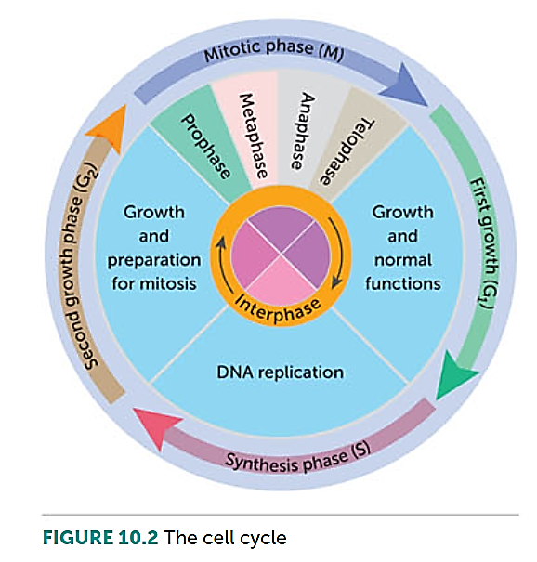
G₂ phase: second growth phase. This relatively short phase involves preparation for cell division.
M phase: mitotic phase. The cell divides into two daughter cells.
G₀ phase: after cell division, cells can leave the cycle and stop dividing for days, years or even for the rest of the person’s life.

Slide 16
Mitosis
It is vital that when a cell reproduces, each new cell gets exactly the same DNA as the parent cell.
Interphase: period between nuclear divisions. During interphase the cell goes through the G₁, S, and G₂ phases of the cell cycle. The quantity of DNA in the nucleus doubles.

Slide 17
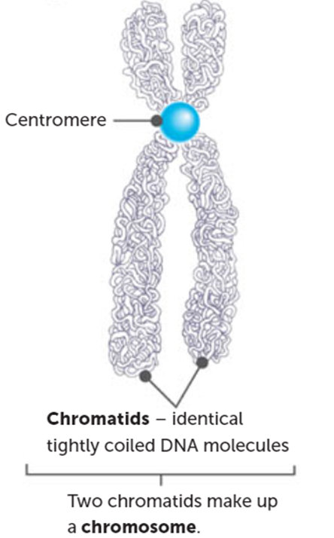
Mitosis
Prophase: first phase of mitosis.
Two pairs of centrioles become visible early in prophase. They move to opposite ends of the cell and microtubule begin to radiate from them.
At the same time, the nucleolus disappears and the nuclear membrane begins to break down. The chromatin threads of DNA become tightly coiled and can be seen as chromosomes.
Coiling the long, delicate DNA molecules makes it easier to distribute the DNA to the daughter cells.

Slide 18
Mitosis
Prophase continued:
Each chromosome consists of two chromatids, which are joined at a point called the centromere.
The two chromatids are identical, tightly coiled DNA molecules produced from DNA replication during interphase. By the end of prophase, the centrioles have reached opposite poles of the cell and some of the microtubules radiating from them join to form a framework of fibres called a spindle.
The nuclear membrane has now completely disappeared, and the chromatid pairs migrate towards the centre (equator) of the cell.

Slide 19
Mitosis
Metaphase: chromatid pairs line up on the equator of the spindle. The centromere of each pair is attached to the spindle fibre.
Anaphase: each pair of chromatids separates at the centromere. As the chromatids have become independent of each other, they are now each called chromosomes. The new chromosomes are then pulled away from one another towards opposite poles of the cell. The centromeres are still attached to the spindle fibres, and it seems that the spindle fibres pull the chromosomes apart in some ways

Slide 20
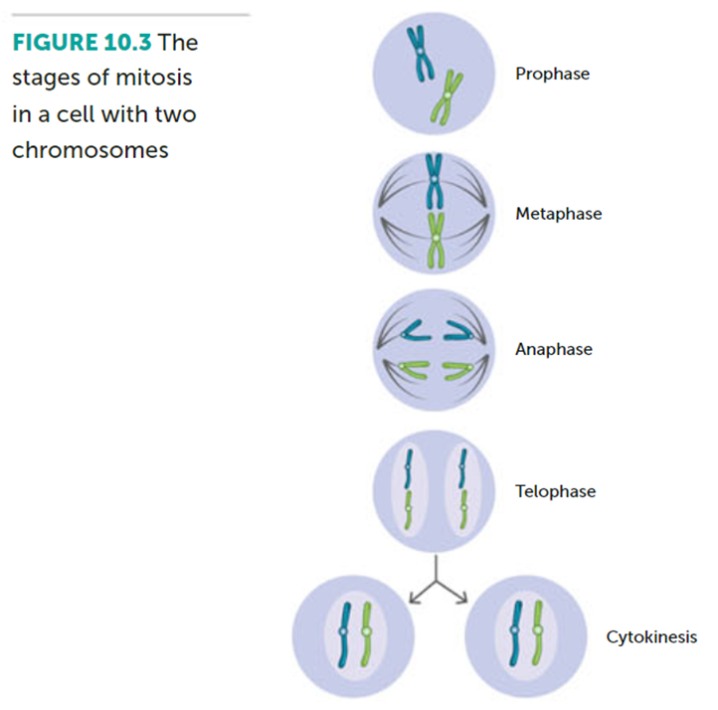
Mitosis
Telophase: the two sets of chromosomes form tight groups at each pole of the cell. A nuclear membrane forms around each group, and a nucleolus appears in each new nucleus. The spindle fibres disappear, and the chromosomes gradually uncoil to become chromatin threads once more.

Slide 21
Mitosis
Cytokinesis: division of the cytoplasm into two parts, each with its own nucleus, and the exact same number and type of chromosomes as the parent cell. The genetic information is therefore passed from parent cell to the daughter cells without change.

Slide 22
Stem Cells
Cells can be classified as either stem cells or specialised cells
In general terms, specialised cells are unable to divide and have to be replaced by other means. When stem cells undergo mitosis, the daughter cells may be new stem cells or cells that differentiate to form specialised cells.

Slide 23
Differentiation
Mitosis ensures that each daughter cell receives the same genes that were in the parent cell. Therefore, every cell in a person’s body has the same genetic information.
The process by which cells become specialised is called differentiation. It seems that as the cells undergo division by mitosis, different genes become activated. This makes the cells differentiate into specialised cells that can perform particular functions.

Slide 24
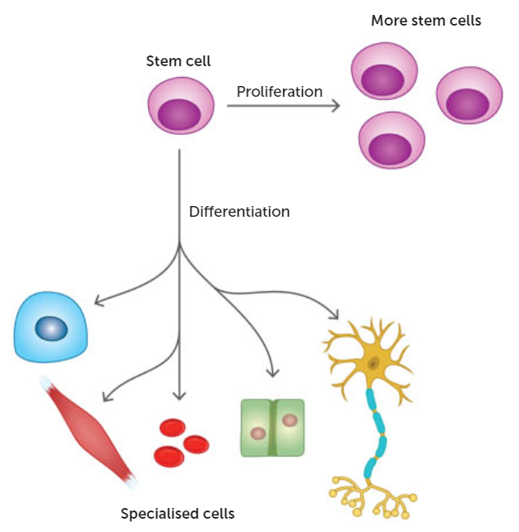

Slide 25
Stem Cells
Cells that can undergo differentiation are called stem cells. They are very different from other cells because they are not specialised and are capable of repeated division by mitosis.
Stem cells have the potential to develop into any cell type. Stem cells can be classified based on where they originate (embryonic, adult or cord blood) or the type of cell that they can form.

Slide 26
Totipotent Stem Cells
Have the potential to create any type of cell necessary for embryonic development, including the embryo itself and all the membranes associated with embryonic development.
The cells of the embryo within the first couple of mitotic divisions after fertilisation are the only totipotent cells.

Slide 27
Pluripotent Stem Cells
Can give rise to any of the cells in the body.
Embryonic stem cells are pluripotent as they differentiate to form all cells of the individual.

Slide 28
Multipotent Stem Cells
Have the potential to form a number of different types of cells.
For example, blood stem cells give rise to red blood cells, white blood cells and platelets, whereas skin stem cells give rise to the different types of skin cells. Embryonic stem cells, adult stem cells and cord blood stem cells are multipotent.

Slide 29
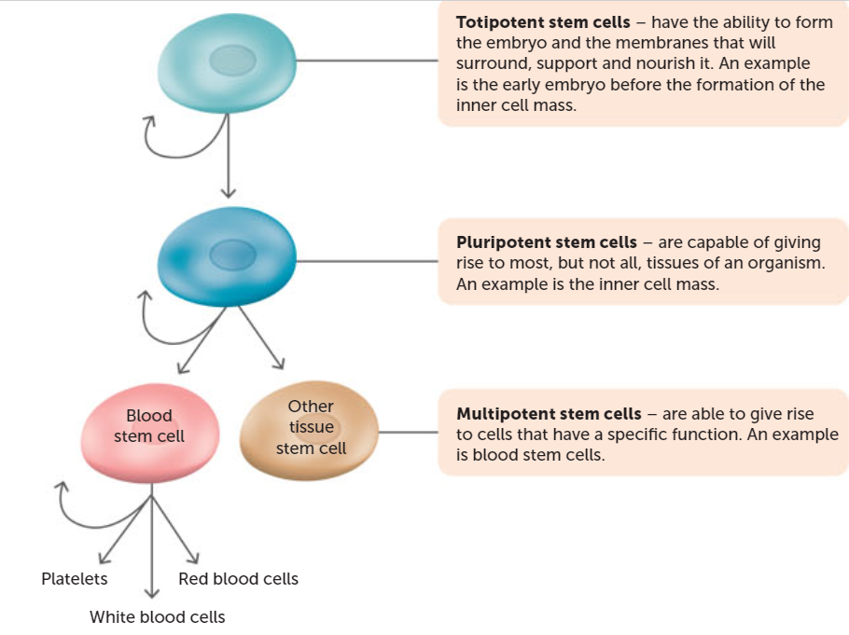

Slide 30
Recall Knowledge
Why do cells need to divide?
List the types of stem cells.

Slide 31
Apply Knowledge
Why would liver cells live for approximately 450 days, while cells lining the stomach live for only 2.9 days?

Slide 32
Homework
What do you think would happen if the spindle fibres did not form in a cell that was undergoing mitosis?

Slide 33
Reading
Pages 249 - 254: Cells divide for growth, repair, replacement and reproduction

